Slide 1
Scaffold analytics figures to modify with chemical structures
Deepak Bandyopadhyay
Rajarshi Guha
Constantine Kreatsoulas

Slide 2
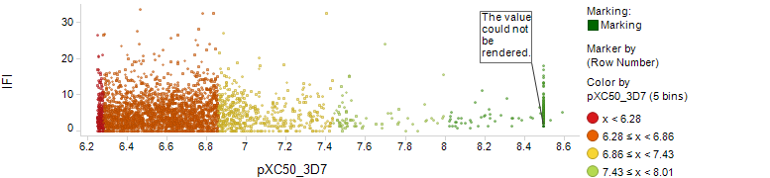
Fig4a

Slide 3
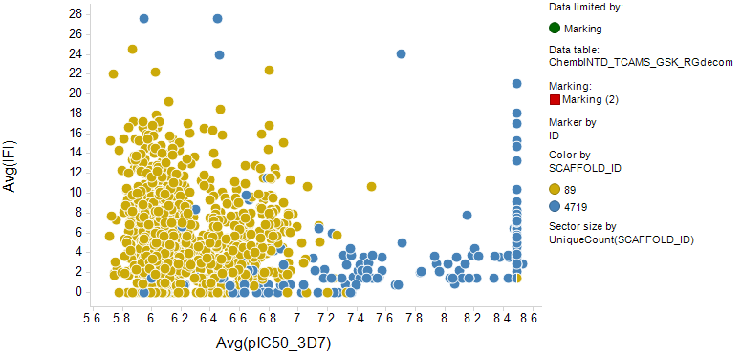
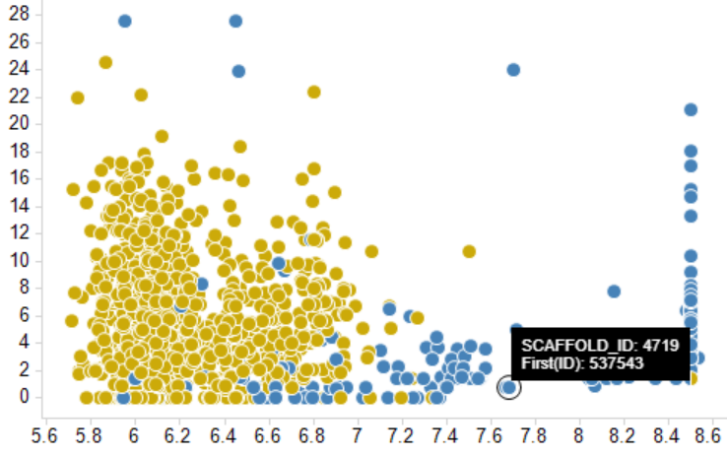
Fig4a bottom

Slide 4
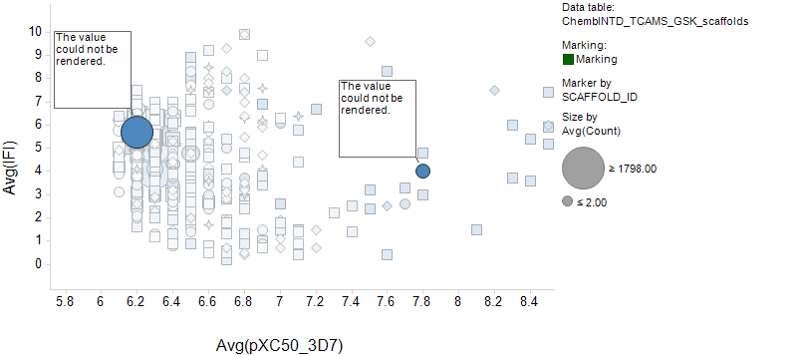
Fig 4b

Slide 5
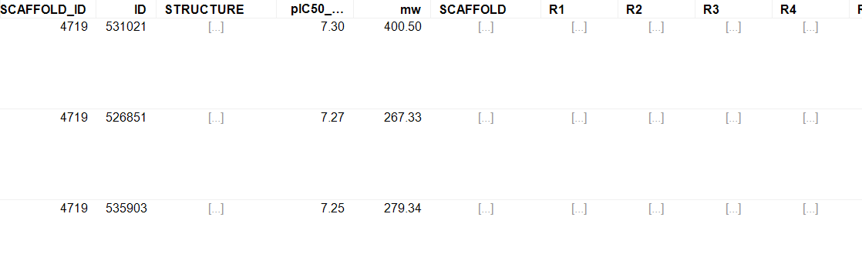
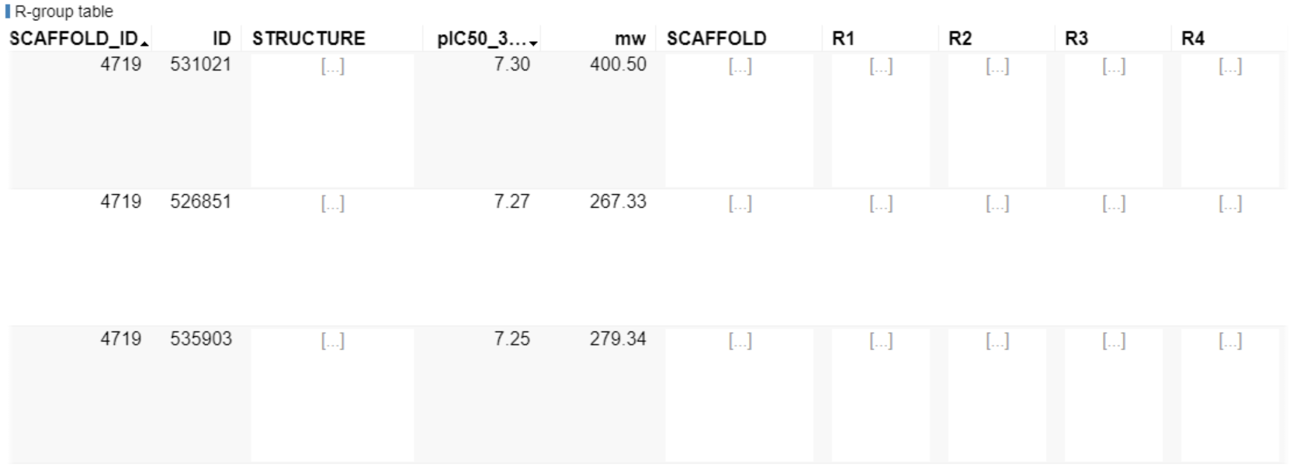
Fig4c

Slide 6
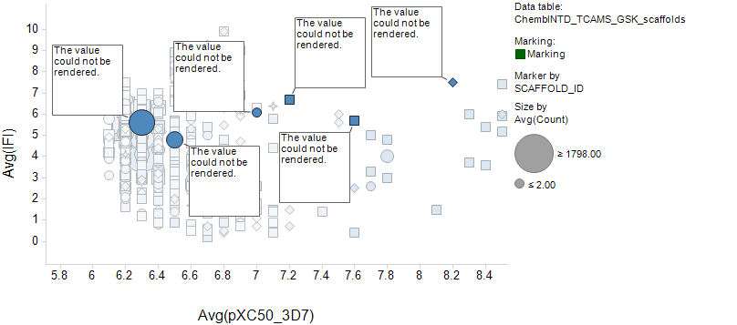
Fig 5b

